Slide 1
Pizza Sales Data Analysis using SQL
-SQL Basics till JOINS
Mehak Sharma

Slide 2
Project Overview
Analyzed a pizza sales database using SQL to extract business insights related to sales performance, customer ordering patterns, and revenue generation.
Key Analysis Performed
- Unique pizza categories ordered - Category-wise sales analysis - Top-selling pizzas - Revenue by pizza size - Average order value - Peak order hours - Daily sales trends - Top revenue-generating pizza types

Slide 3
SQL Concepts Used
- JOINs - GROUP BY - HAVING - Aggregate Functions - Date Functions - Sorting and Filtering
Tools Used
- SQL Server - GitHub

Slide 4
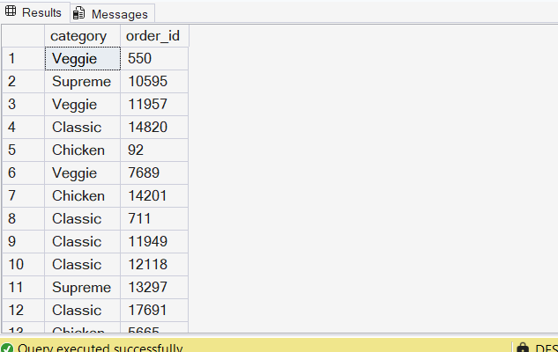
Q1. List all unique pizza categories that were ever ordered.
select distinct pt.category, od.order_id from pizza_types pt join pizzas p
on pt.pizza_type_id = p.pizza_type_id join order_details od
on p.pizza_id = od.pizza_id

Slide 5
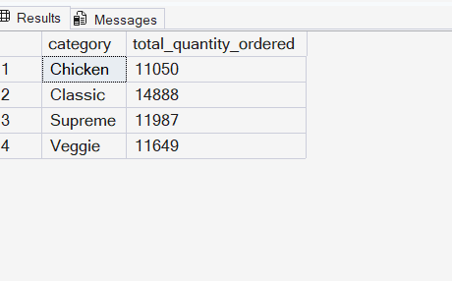
Q2. Find the total quantity ordered for each pizza type.
select pt.category, sum(od.quantity) as total_quantity_ordered
from pizza_types pt join pizzas p on pt.pizza_type_id = p.pizza_type_id
join order_details od on p.pizza_id = od.pizza_id
group by pt.category

Slide 6
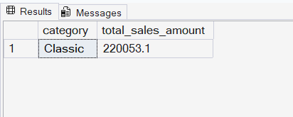
Q3. Which pizza category had the highest total sales amount?
select top 1 pt.category, round(sum(p.price*od.quantity),2) as total_sales_amount
from pizza_types pt join pizzas p
on pt.pizza_type_id = p.pizza_type_id
join order_details od on p.pizza_id = od.pizza_id
group by pt.category
order by sum(p.price*od.quantity) desc

Slide 7
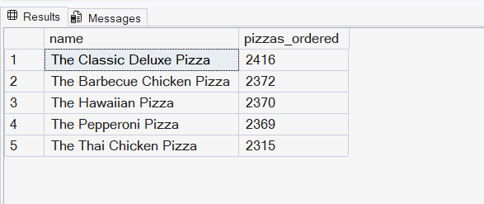
Q4. Show the top 5 most frequently ordered pizzas.
select top 5 pt.name, count(od.order_id) as pizzas_ordered
from pizza_types pt join pizzas p
on pt.pizza_type_id = p.pizza_type_id join order_details od
on p.pizza_id = od.pizza_id
group by pt.name
order by count(od.order_id) desc

Slide 8
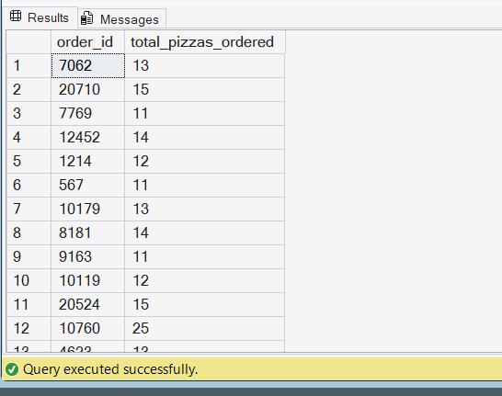
Q5. List all orders where more than 10 pizzas were ordered in total.
select order_id, sum(quantity) as total_pizzas_ordered
from order_details group by order_id
having sum(quantity) > 10

Slide 9
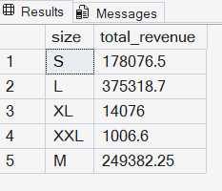
Q6. Find the total revenue generated by each pizza size.
select p.size, round(sum(p.price*od.quantity),2) as total_revenue
from pizzas p join order_details od
on p.pizza_id = od.pizza_id
group by p.size

Slide 10
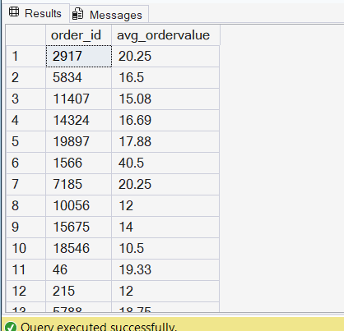
Q7. What is the average order value per order?
select od.order_id, round(AVG(od.quantity* p.price),2) as avg_ordervalue
from order_details od join pizzas p
on od.pizza_id = p.pizza_id
group by od.order_id

Slide 11
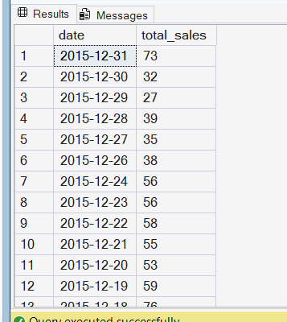
Q8. Show daily total sales, sorted by date in descending order.
select date, count(order_id) as total_sales from orders
group by date
order by date desc

Slide 12
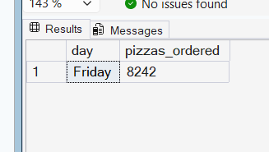
Q9. Which day had the highest number of pizzas sold?
select top 1 datename(weekday,o.date) as day, sum(od.quantity) as pizzas_ordered
from order_details od join orders o
on od.order_id = o.order_id
group by datename(weekday,o.date)
order by sum(od.quantity) desc

Slide 13
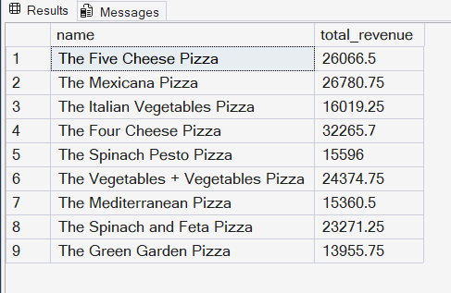
Q10. Find total revenue per pizza type, only for "Veggie" category.
select pt.name, round(sum(p.price*od.quantity),2) as total_revenue
from pizza_types pt join pizzas p on pt.pizza_type_id = p.pizza_type_id
join order_details od on p.pizza_id = od.pizza_id
where pt.category = 'Veggie’ group by pt.name

Slide 14
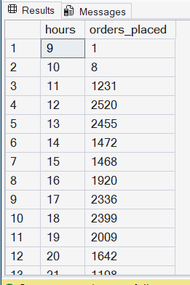
Q11. Count how many orders were placed each hour.
select DATEPART(hour,time) as hours, count(order_id) as orders_placed
from orders
group by DATEPART(hour,time)
order by hours

Slide 15
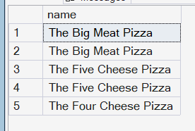
Q12. List all pizzas that were never ordered.
select pt.name from pizza_types pt left join pizzas p
on pt.pizza_type_id = p.pizza_type_id left join
order_details od on p.pizza_id = od.pizza_id
where od.order_id is null

Slide 16
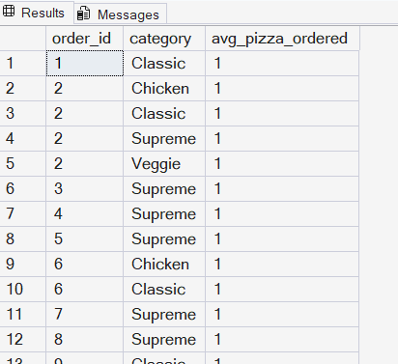
Q13. Show the average number of pizzas ordered per order per category.
select od.order_id, pt.category,avg(od.quantity) as avg_pizza_ordered
from pizza_types pt join pizzas p on pt.pizza_type_id = p.pizza_type_id
join order_details od on od.pizza_id = p.pizza_id
group by od.order_id, pt.category
order by od.order_id

Slide 17
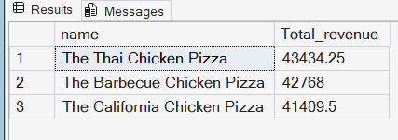
Q 14. Find the top 3 earning pizza types.
select top 3 pt.name, sum(od.quantity*p.price) as Total_revenue
from pizza_types pt join pizzas p
on pt.pizza_type_id = p.pizza_type_id
join order_details od
on od.pizza_id = p.pizza_id
group by pt.name
order by Total_revenue desc

Slide 18
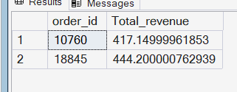
Q15. List total revenue per order, but only show those orders where revenue > $300
select od.order_id, sum(od.quantity*p.price) as Total_revenue
from pizzas p join order_details od
on p.pizza_id = od.pizza_id
group by od.order_id
having sum(od.quantity*p.price) > 300

Slide 19
Thank you
Mehak Sharma
SQL Data Analysis Project

